Slide 1

Strategies for generating personalized advertisements using Generative AI
Ming

Slide 2
The history of "finding information" has evolved over time
File Age: Paper, stone.
Database Evolution:
Hierarchical Database: Emerged in the 1950s to 1960s, based on a tree structure.
Network Database: Used from the 1960s to the 1970s, allowing more complex relationship graph structures.
Relational Database: From the 1970s to the present, proposed by E.F. Codd, uses table structures, and became the mainstream database model (MSDB).
Data Retrieval: The development from manual systems (such as card indexes) to complex digital search engines, discussing how search engines like Google have revolutionized the way we retrieve information by providing relevant search results quickly through complex algorithms.
Notes:
檔案時代：從早期的資料儲存談起，比如紙本記錄和在石頭上記錄資料。
資料庫演進：
階層式資料庫：於1950至1960年代出現，基於樹狀結構。
網狀式資料庫：1960至1970年代使用，允許更複雜的關係圖結構。
關聯式資料庫：1970年代至今，由E.F. Codd提出，使用表格結構，成為主流的資料庫模型​ (HarperDB)​。
資料檢索：從手動系統（如卡片索引）到複雜的數位搜尋引擎發展的歷程，談論像Google這樣的搜尋引擎是如何通過複雜演算法快速提供相關搜尋結果，從而改革了我們檢索資訊的方式​ 。
索引編制：一旦網頁被抓取，Google會分析網頁上的內容，包括文本、圖片和視頻檔，並將這些資訊存儲在一個大型資料庫中，這就是所謂的Google索引。

Slide 3
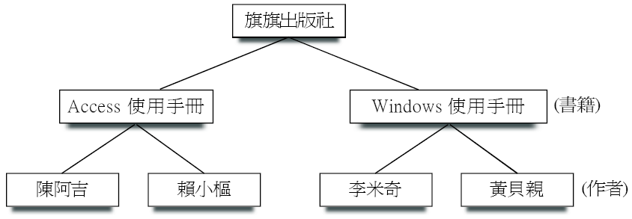
Hierarchical Database
A data model that uses a tree structure to describe entities and their relationships.
The advantage of this type is that the data structure is pyramid-like, making it very straightforward and clear to describe data at different levels within the same category.
The downside is that when the relationships between data become complex, it leads to inconvenience in management and maintenance.

Slide 4
Network Database
Network databases are essentially an expansion of hierarchical databases.
Imagine each record as a node, and relationships can be established between nodes (that is, associations between records), creating a complex network structure.
The advantage is that it avoids the issue of data duplication found in hierarchical databases, but the downside is that the relationships become more complex, especially as the database grows, maintaining these connections can become quite intricate.

Slide 5
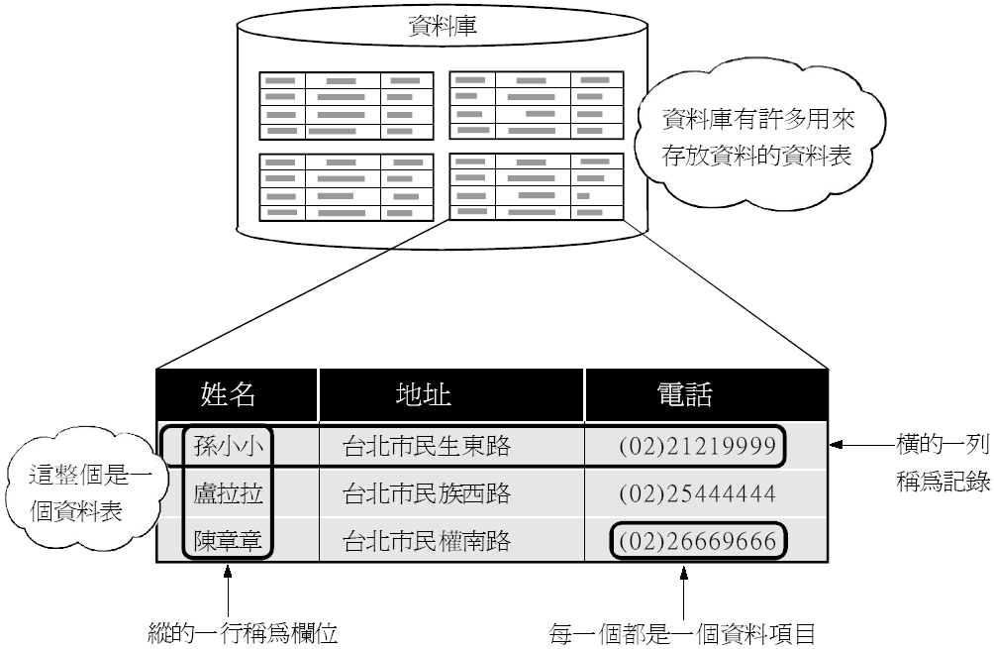
Relational Database
Relational databases store data in a two-dimensional matrix, where the information stored in rows and columns is interconnected.
This interconnected nature of the stored data is why it's called a 'relational' database.

Slide 6
The history of "finding information" has evolved over time
Technological Progress:
Magnetic Storage: Includes drum storage, tape drives, and hard disk drives.
Semiconductor Memory: Such as RAM chips, significantly increasing data access speed and capacity.
Optical Discs: Like CDs and DVDs, use light to encode and decode information for data storage.
Flash Memory: Offers durable and portable storage solutions without moving parts, aiding in data mobility.
Modern Developments: Discusses the evolution of modern database technologies, such as NoSQL databases for handling large-scale distributed data, and the rise of cloud storage, where data is stored in virtualized pools typically hosted by third parties, making information accessible from any internet-connected location.
Notes:
磁性儲存：這種技術的出現，使得人們可以快速地找到和存取大量的資料，而不需要手動地去查找紙質的檔案或記錄。
半導體記憶體：這種技術的進步，使得電腦能夠快速地處理大量的資料，從而提高了資料處理和搜尋的效率。
光碟：光碟的出現，使得資料能夠被大量地儲存並且能夠被方便地攜帶和分發，這對於資料的共享和傳播有著重要的影響。
快閃記憶體：快閃記憶體的出現，使得資料能夠被更快速地存取，並且能夠被方便地攜帶和傳輸，這對於移動裝置的資料存取和處理有著重要的影響。

Slide 7
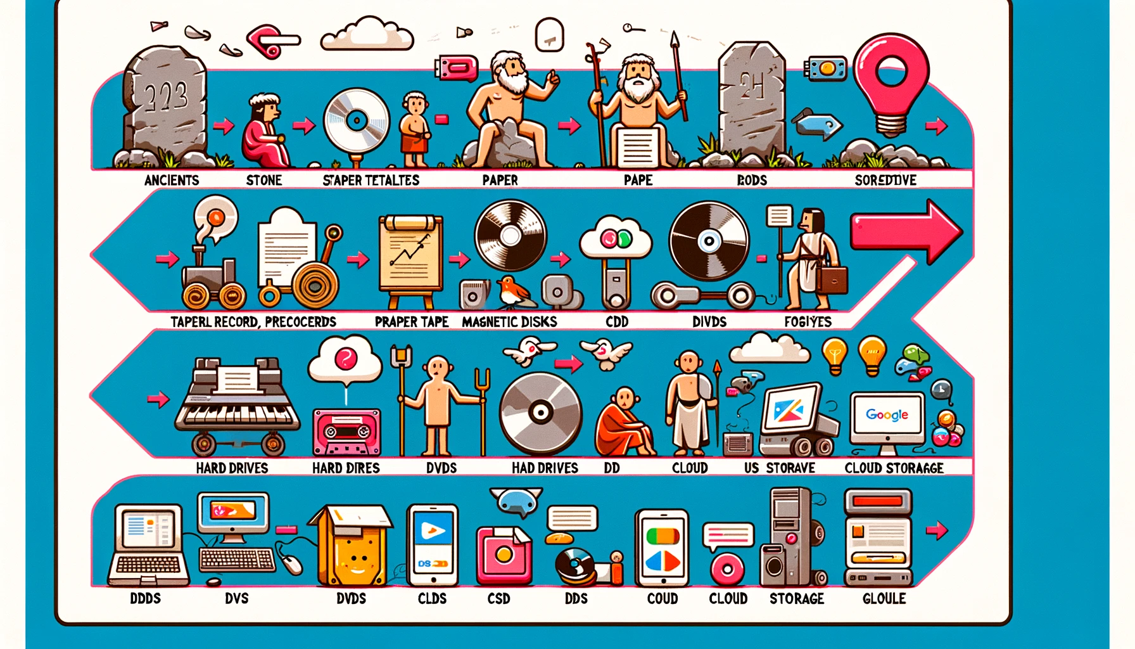
Notes:
從古代的石板到紙質記錄、磁帶、軟碟、硬碟、CD、DVD、USB閃存盤、雲儲存，以及最終的現代搜尋引擎如Google的發展過程

Slide 8
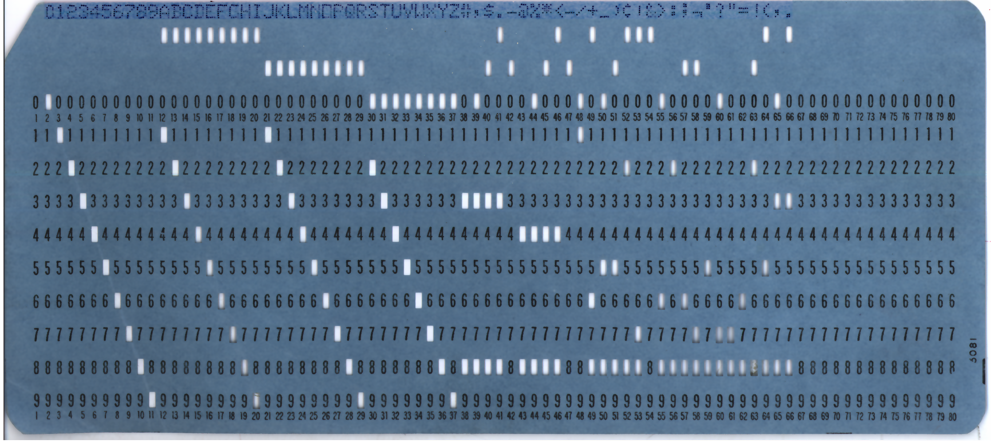
data retrieval
Manual Retrieval Era:
Before the advent of computers, data retrieval was entirely manual.
The earliest retrieval systems included library card catalogs, file cabinets, index cards, and bibliographies.
Mechanized Retrieval Era:
At the beginning of the 20th century, with the introduction of mechanized office equipment like typewriters and photocopiers, data retrieval began to semi-automate.
Electronic Data Retrieval Era:
In 1945, Vannevar Bush proposed the concept of "Memex," an imaginary device considered a precursor to computer-based data retrieval systems.
In the 1950s, with the advent of computers, punched card-based retrieval systems emerged.
Online Databases and Retrieval Systems:
The 1960s saw the first online data retrieval systems, allowing databases to be accessed directly through remote terminals.
Over the following decades, academic databases (like Medline) and commercial databases (like LexisNexis) provided large-scale, searchable data collections.

Slide 9
data retrieval
Full-Text Search and Search Engines:
In the 1990s, as the internet became widespread, full-text search became feasible, allowing users to search for specific words or phrases within a large volume of documents.
The development of search engines like Google completely transformed the landscape of data retrieval. They use complex algorithms to index information on the web and provide results relevant to user queries.
Semantic Search and Personalization:
The latest search technologies begin to understand the context and intent of queries, providing personalized results.
Using machine learning and artificial intelligence, modern search engines can predict user needs and deliver more accurate search results.
Multimedia and Cross-Language Search:
With the growth of multimedia content, data retrieval has expanded beyond text to include images, videos, and audio.
Cross-language search technologies allow users to search and access information across language barriers.
Social Search and Big Data:
The rise of social media and big data presents new challenges and opportunities for data retrieval, requiring search systems to handle and analyze vast amounts of unstructured data.

Slide 10
The Evolution of Chat Technologies
Exclusive System Chats:
These are chat systems tailor-made for specific applications or organizations.
They offer a high degree of customization, integration with specific business processes, and enhanced data privacy and security.
Chat Robots:
These are rule-based automated response systems.
They are commonly used in customer service support to handle frequent inquiries and requests.

Slide 11
The Evolution of Chat Technologies
Non-Exclusive System Chat
Chat systems not limited to a specific application and widely usable for a variety of scenarios, more generalized and scalable.
Generative AI (e.g., ChatGPT, Copilot)
Artificial intelligence that generates responses through machine learning, capable of creating new conversational content, not limited to predetermined responses.

Slide 12
Large Language Model (LLM)
Structure: They are typically based on neural networks, particularly variants of deep learning like the Transformer architecture.
Training Process: These models learn language patterns and structures through a large amount of text data, which comes from books, articles, websites, etc.
Functions of LLMs:
Language Understanding: Grasping the semantics of text.
Text Generation: Producing coherent text.
Language Translation: Translating between different languages.
Question-Answering Systems: Responding to user queries.
Summary Creation: Condensing lengthy text into refined summaries.
Notes:
LLM的功能
語言理解：LLM可以理解文字的語義和語境，即使是含糊或雙關語。
文字生成：它們能夠生成連貫的文字，包括文章、故事、代碼甚至詩歌。
語言翻譯：LLM能夠翻譯不同語言間的文字，並保留原文的意義和風格。
問答系統：可以對用戶的問題進行回答，提供有用和準確的資訊。
摘要創建：能夠將長篇文字縮短為精練的摘要。

Slide 13
Large Language Model (LLM)
Applications of Large Language Models (LLMs)
Automatic Writing Assistant: Assists authors in generating content.
Dialogue Systems: Engage in natural and fluent conversations.
Code Generation: Writing and debugging code.
Educational Tools: Customized learning materials and exercises.
Challenges and Limitations of LLMs
Ethics and Bias: Biases in training data may be reflected in the model's responses.
Privacy Issues: When handling sensitive data, compliance with privacy protection standards is essential.
Interpretability: The decision-making process of LLMs may lack transparency, making it challenging to understand how they arrive at specific outputs.
Notes:
LLM的應用場景
自動寫作助手：幫助作者生成內容，提出寫作建議。
對話系統：在聊天機器人和虛擬助手中進行自然而流暢的對話。
程式碼生成：輔助開發人員編寫和偵錯程式碼。
教育工具：作為學習平台，提供定製化的學習材料和練習。
LLM的挑戰與侷限
倫理和偏見：訓練數據中的偏見可能會反映在模型的回應中。
隱私問題：處理敏感數據時，必須確保遵守隱私保護標準。
解釋性：LLM的決策過程可能缺乏透明度，讓人難以理解它們是如何得出特定輸出的。

Slide 14
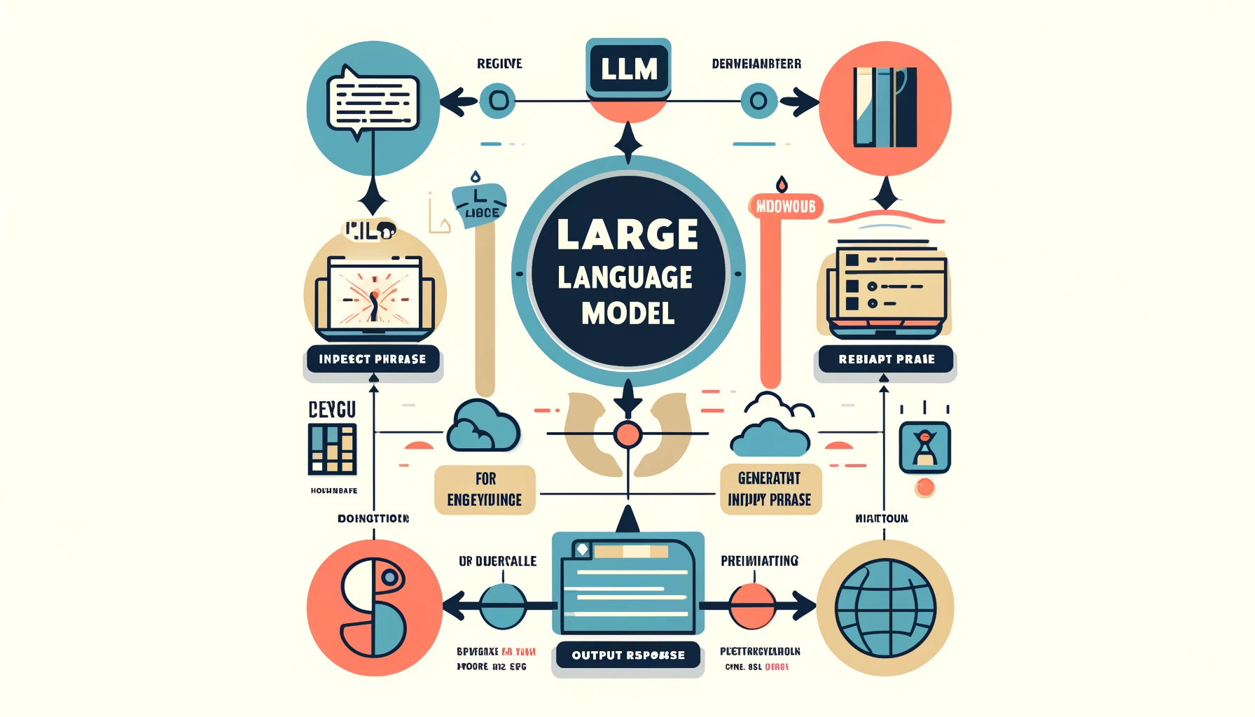

Slide 15
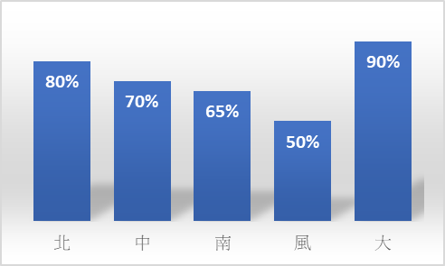
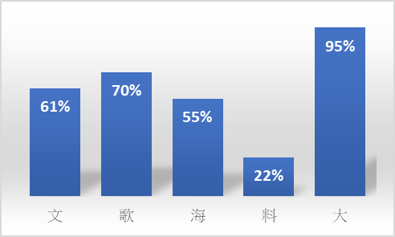
Principles of Generative AI – Chain Reaction
北
台灣最頂尖的科技大學是哪間？台
灣
中
…
文
台灣最頂尖的科技大學是哪間？台灣
大
哥
…

Slide 16
Prompt engineering
Suggestions:
(1) Clear instructions.
(2) Thought-provoking guidance.
PROMPT Elements:
(1) Person: The role to be played.
(2) Task: The task to be assigned.
(3) Object: The result to be produced.

Slide 17
Prompts Template Website
AIPRM for ChatGPT
https://app.aiprm.com/?trk=public_post-text
Awesome ChatGPT Prompts
https://github.com/f/awesome-chatgpt-prompts
EasyPrompt Library
https://library.easyprompt.xyz/

Slide 18
Generative AI Applications in Daily Life
Content Creation:
Generative AI can write articles, compose music, create images, and even produce videos.
Virtual Assistants:
Intelligent virtual assistants can use generative AI to provide more natural conversational responses, schedule appointments, answer questions, or perform small tasks.
Language Translation:
Advanced generative AI models are capable of real-time language translation and instant subtitling.

Slide 19
Examples of Everyday Applications
MUSIC：
https://www.aiva.ai/
https://soundful.com/
PICTURE：
https://openai.com/dall-e-3
https://www.midjourney.com/home
EXAMPLE：
https://www.youtube.com/@LofiGirl/videos

Slide 20
Generative AI Business Applications
Content Creation:
Automate the generation of marketing content such as ad copy, social media posts, and blog articles.
Personalized Experience:
Provide ecommerce customers with personalized product descriptions and recommendations.
Data Analysis and Insights:
Use generative models to analyze big data and extract trends and patterns to support decision-making.
Automatically generate reports and visualize data to aid in understanding complex datasets.
Notes:
內容創作：
自動生成市場營銷內容，如廣告文案、社交媒體帖子和部落格文章。
產生個性化的電子郵件響應和新聞稿。
個性化體驗：
為電子商務客戶提供個性化的產品描述和推薦。
在線客服中使用AI來提供個性化的客戶服務和支援。
數據分析與洞察：
利用生成式模型對大數據進行分析，提取趨勢和模式，以支援決策制定。
自動生成報告和視覺化數據，以幫助理解複雜的數據集。
自動化設計：
使用AI來創建和修改產品設計，如時尚設計、建築圖紙或UI/UX介面。
為用戶提供個性化的設計選項和變體。
模擬與預測：
在金融領域，利用生成式模型來模擬市場場景和投資組合管理。
在製造業中模擬新的產品生產流程和供應鏈變動。
程式碼生成和輔助：
生成代碼片段來輔助開發過程或自動化簡單的編程任務。
使用AI來進行代碼審查和錯誤修復建議。
法律和合同自動草擬：
自動生成或修改合同文檔和法律條款，節省法律專業人士的時間。
輔助進行法律研究，快速找到相關的案例和引用。

Slide 21
Generative AI Business Applications
Simulation and Forecasting:
In the financial sector, generative models are used to simulate market scenarios and manage investment portfolios.
In manufacturing, they simulate new product production processes and supply chain changes.
Code Generation and Assistance:
Generate code snippets to aid the development process or automate simple programming tasks.
Automated Drafting of Legal and Contractual Documents:
Automatically generate or modify contract documents and legal provisions, saving time for legal professionals.

Slide 22
Business Application Examples
https://www.youtube.com/watch?v=S7xTBa93TX8

Slide 23
Traditional Advertising Creation Method
Product Selection
Select promotional products
Ad Writing
The company thinks about the push advertising content
Broadcasting
Sending out the advertisements via SMS

Slide 24
Generating advertisements using Generator-GPA
Personalization
Collecting Consumer Data
Copywriting
Tracking Individual Footprints
Deployment
SMS Broadcasting
Compiling into Personalized Profiles
App Deployment
Coupon Distribution
Generating Copy
Notes:
自動化生成個人化廣告

Slide 25
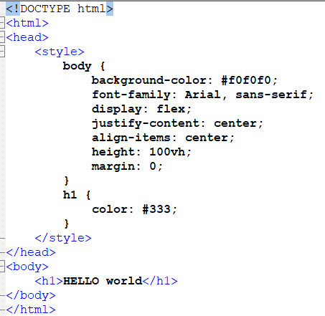
Python-generated webpage
Traditional Webpage Creation Uses:：
HTML + CSS
What if you don't know HTML + CSS?
Python + Streamlit

Slide 26
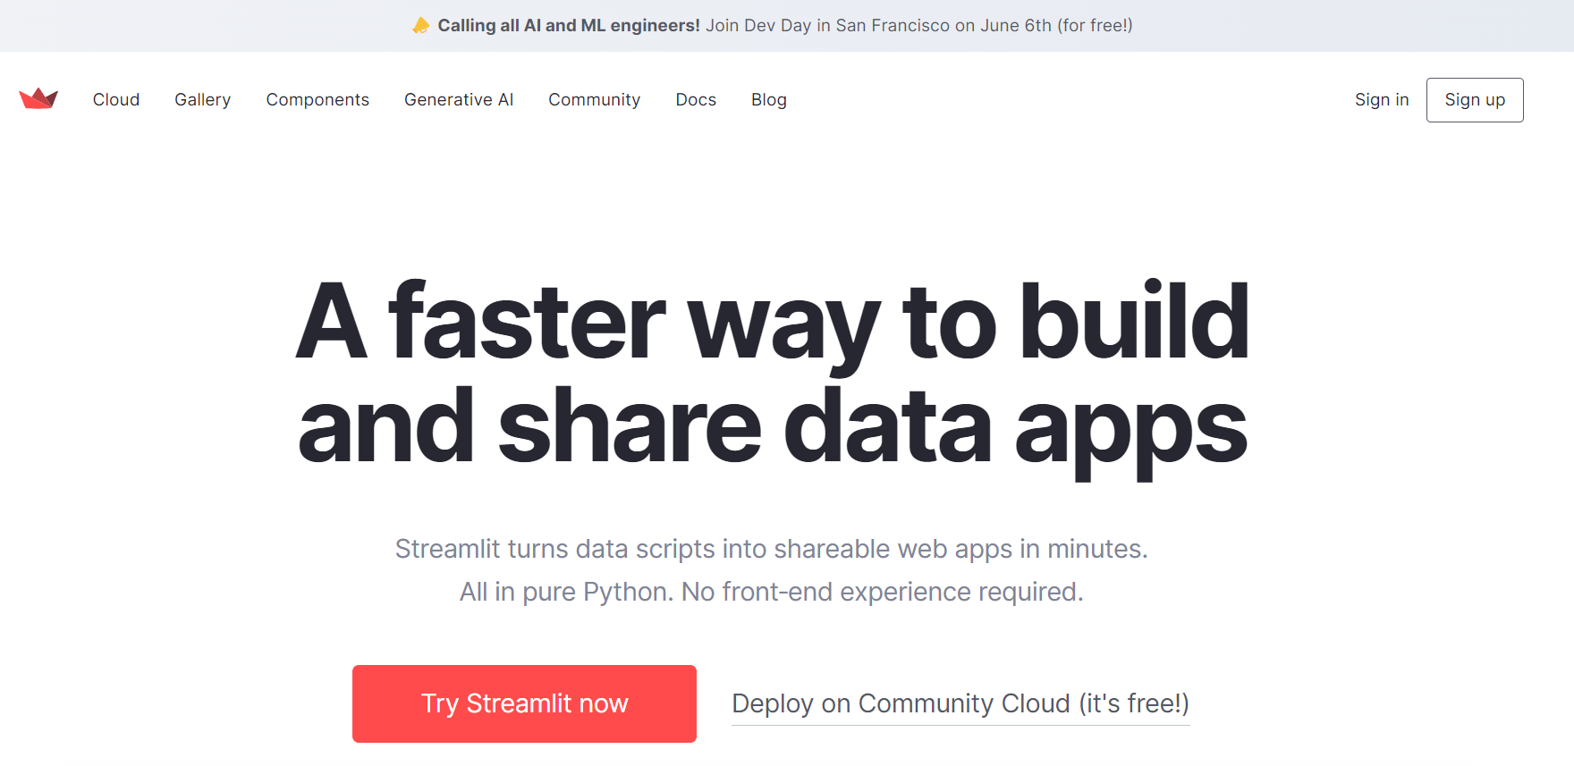
Streamlit
https://streamlit.io/

Slide 27
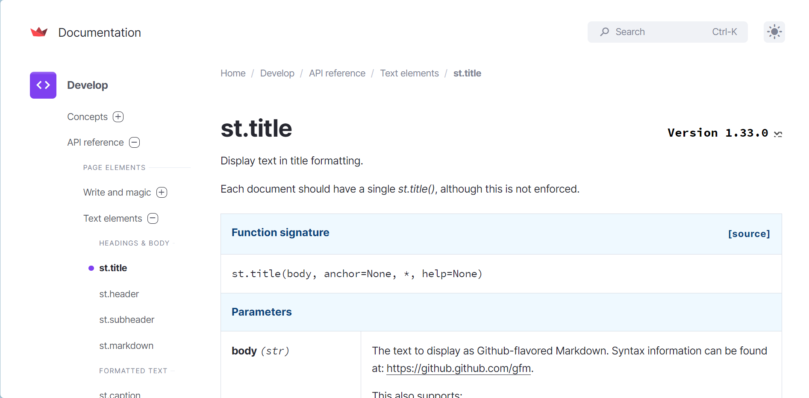
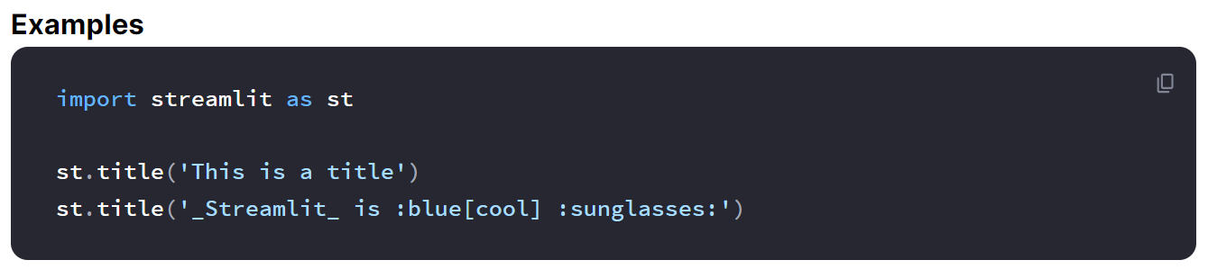
Documentation

Slide 28
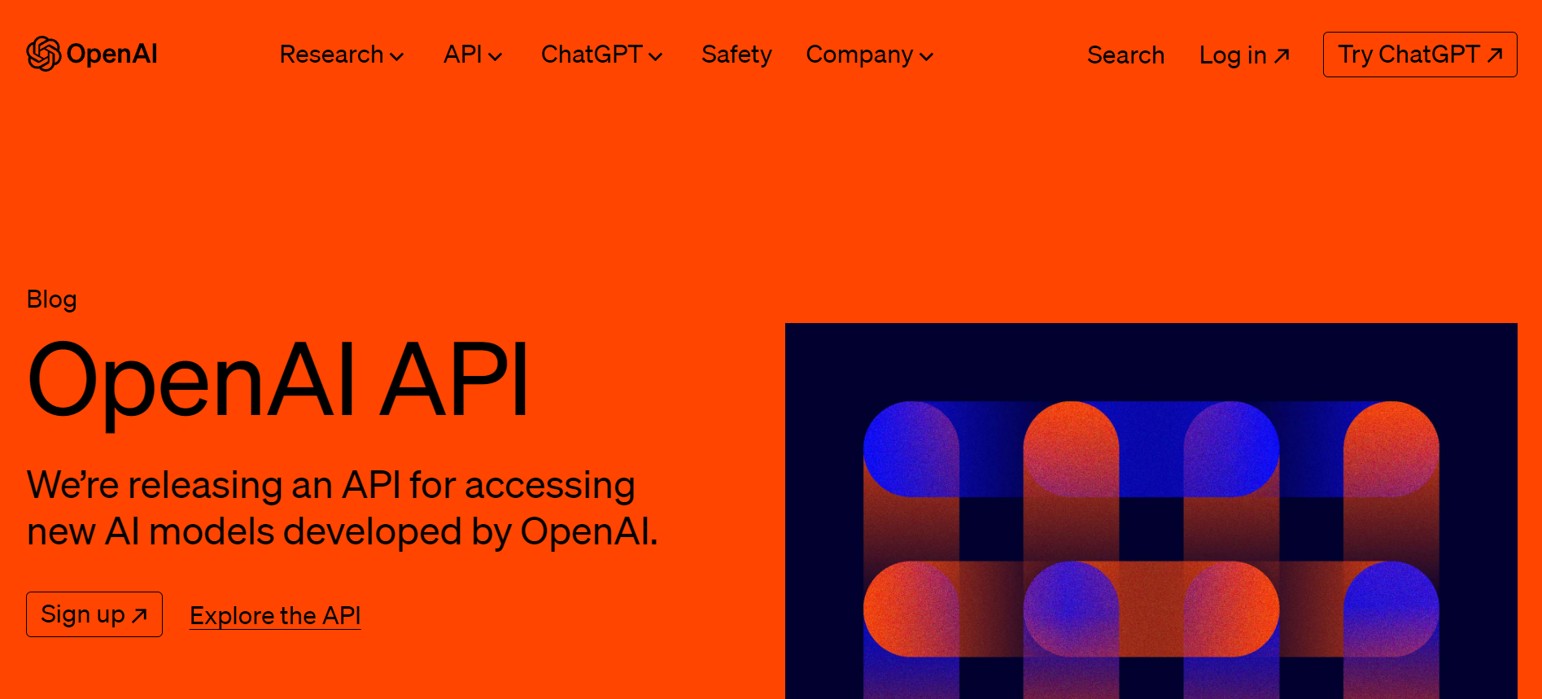
Apply for an OPENAI API KEY

Slide 29
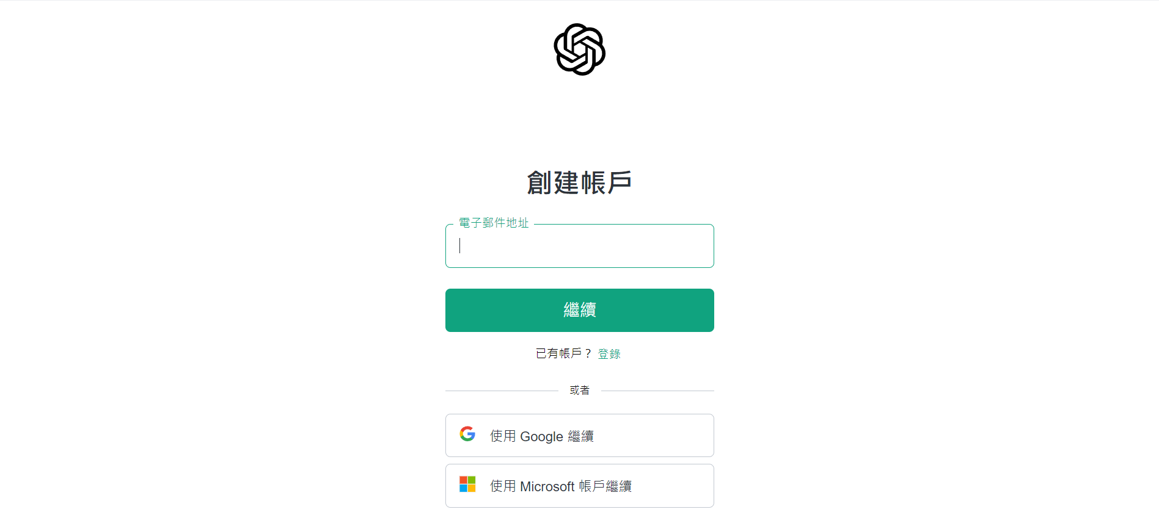
Apply for an OPENAI API KEY

Slide 30
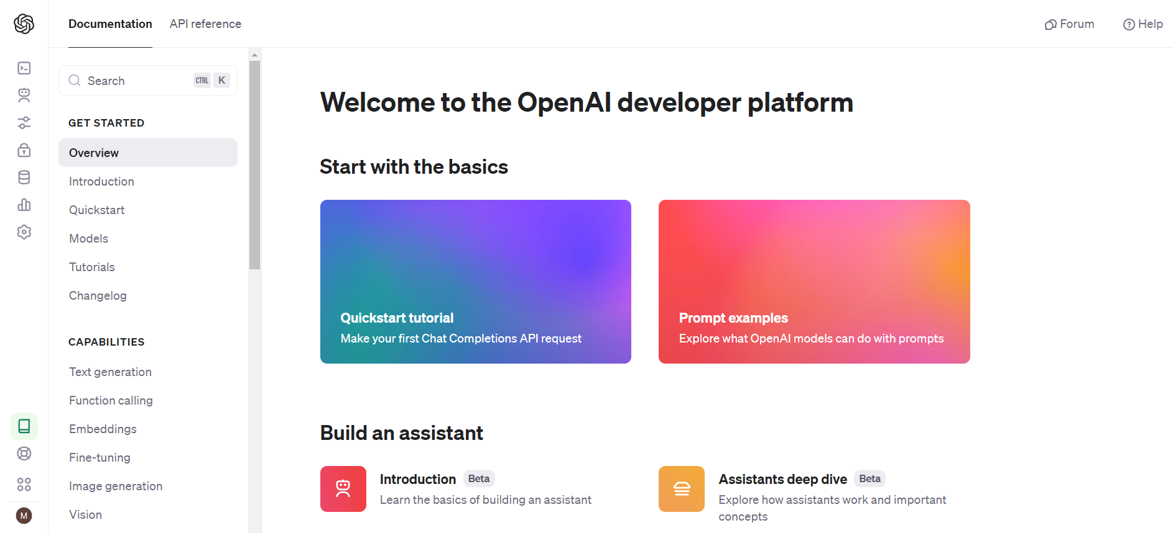
Apply for an OPENAI API KEY

Slide 31
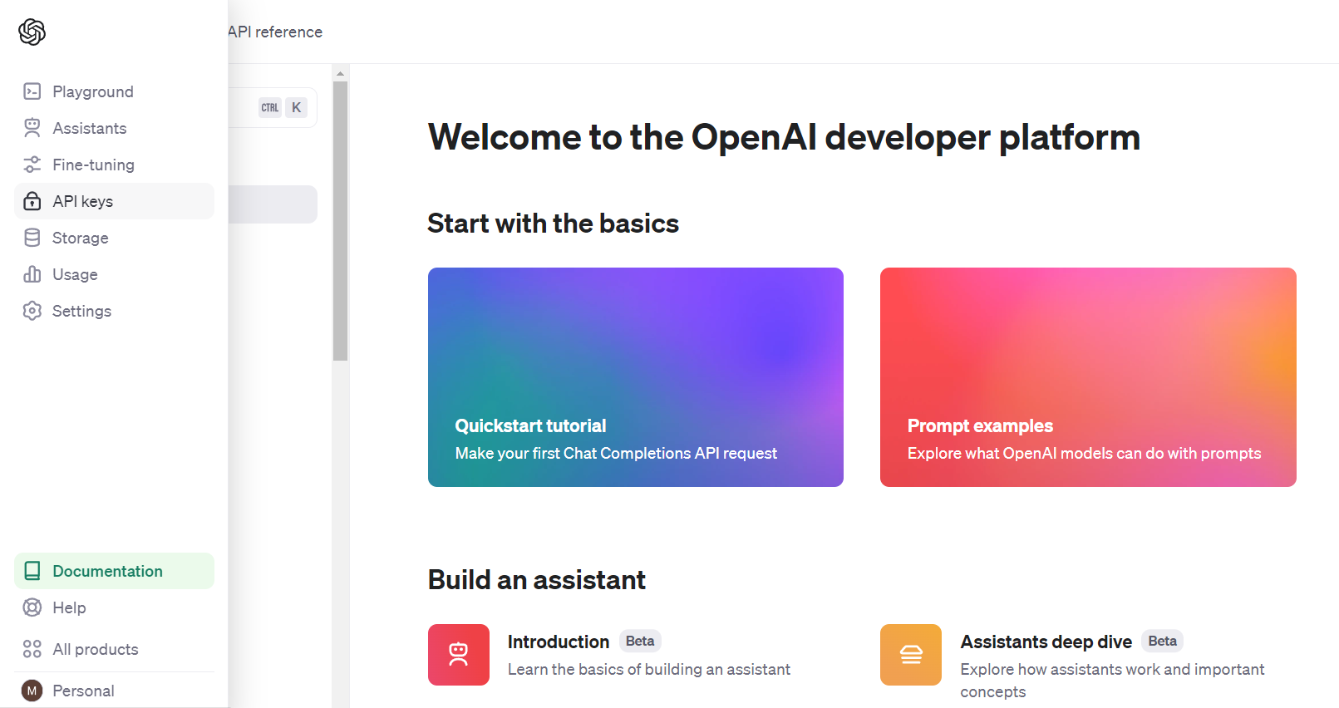
Apply for an OPENAI API KEY

Slide 32
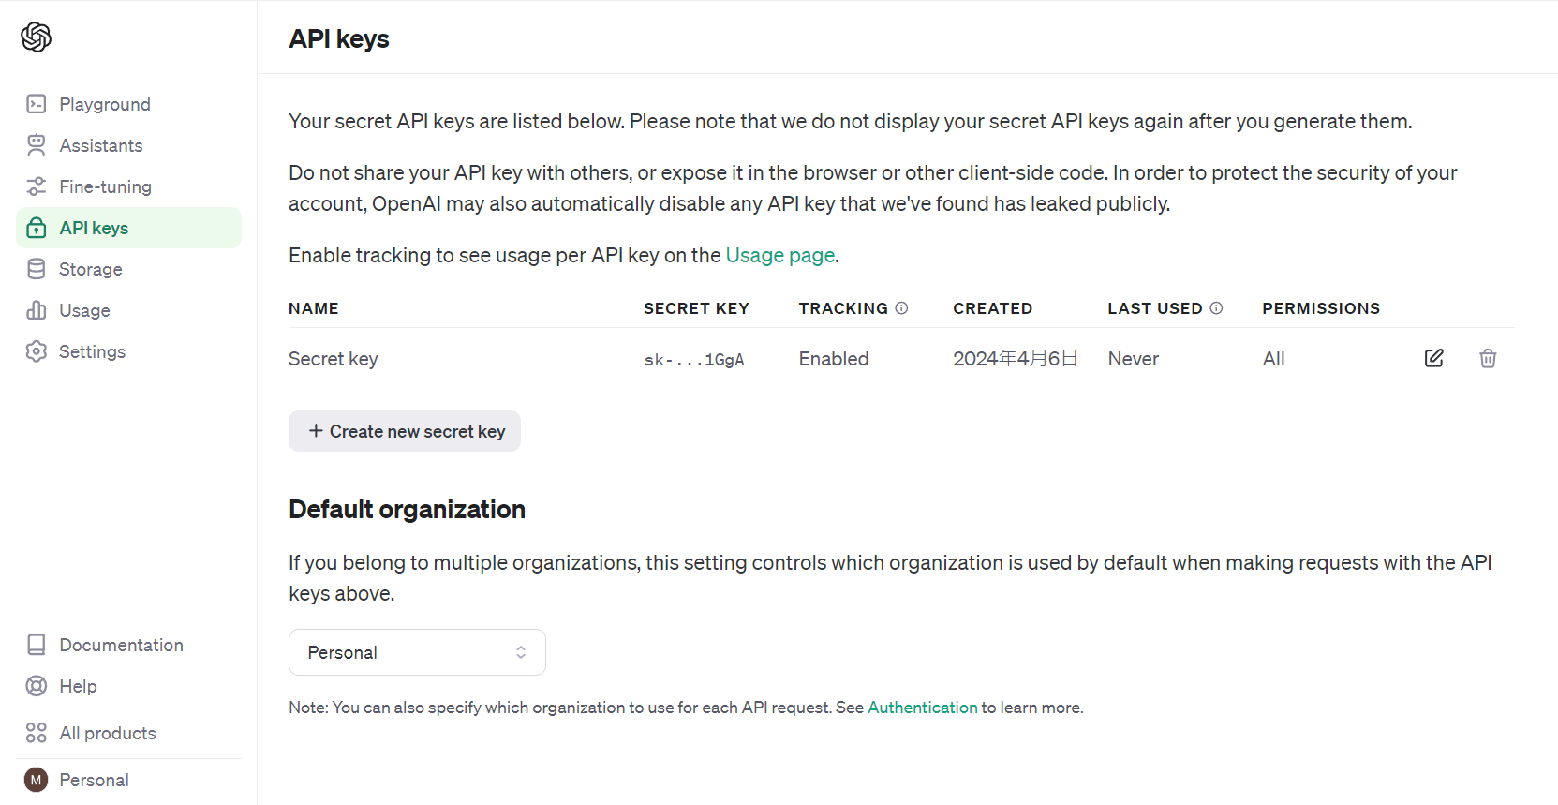
Apply for an OPENAI API KEY
Remember to save your API KEY securely; once you close the pop-up window, you won't be able to see the full API KEY again.

Slide 33
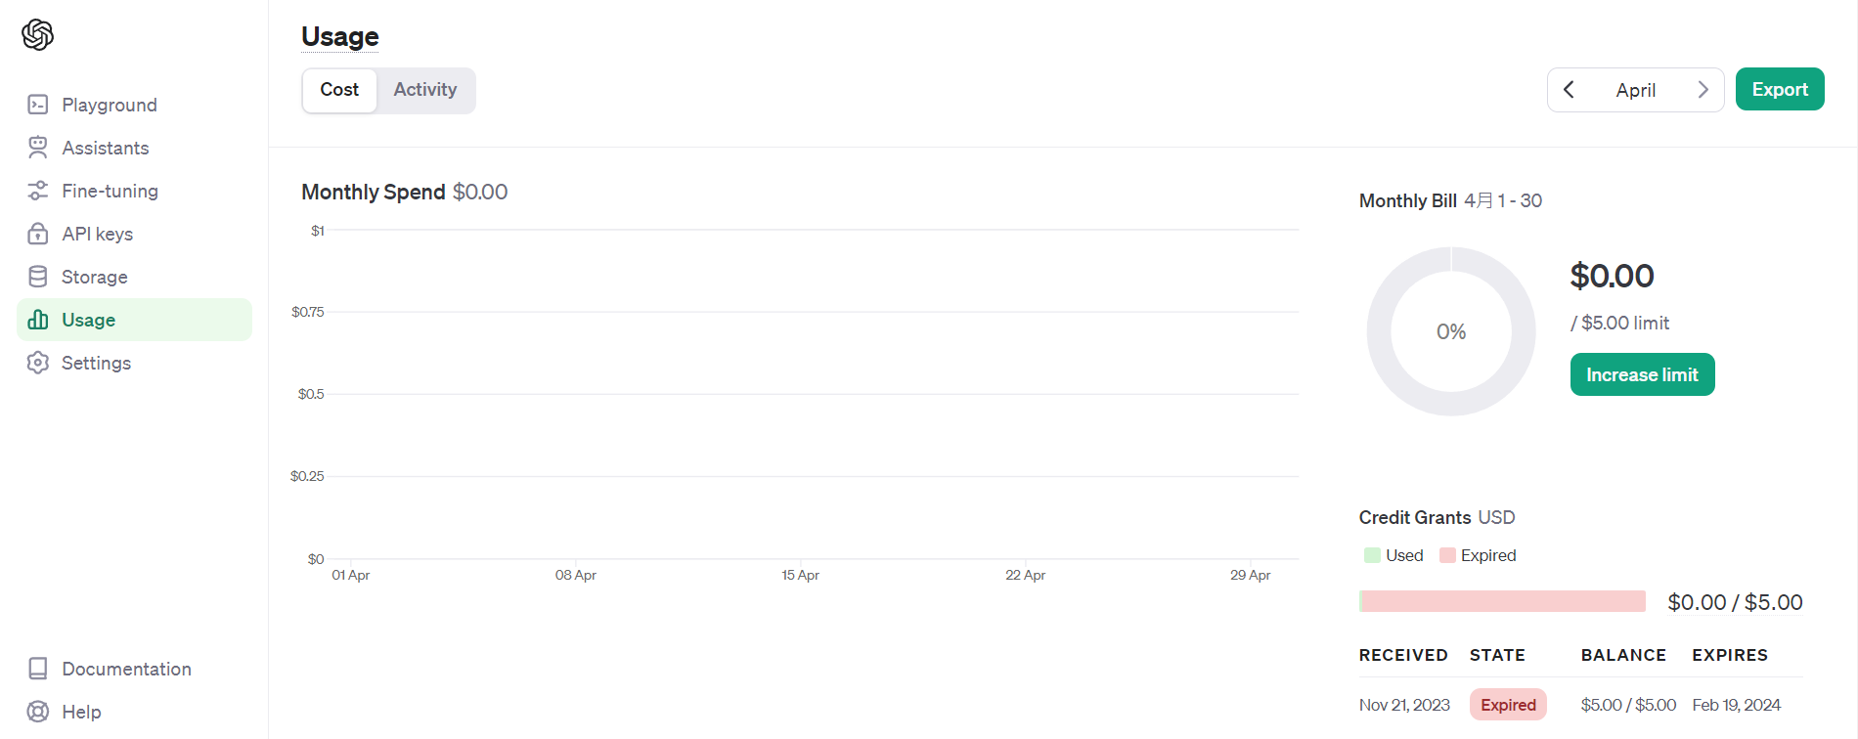
Check API Key Balance
https://platform.openai.com/usage

Slide 34
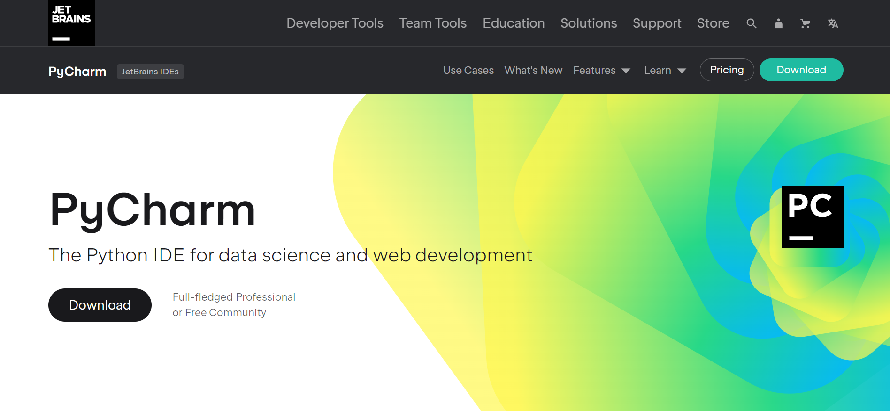
Pycharm

Slide 35
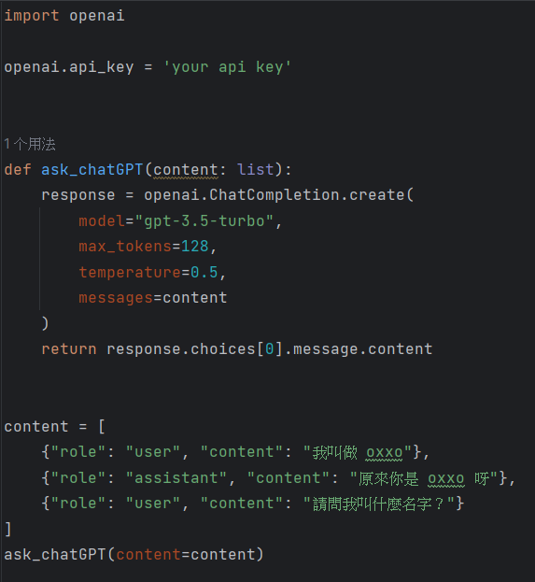
Testing API KEY with Python

Slide 36
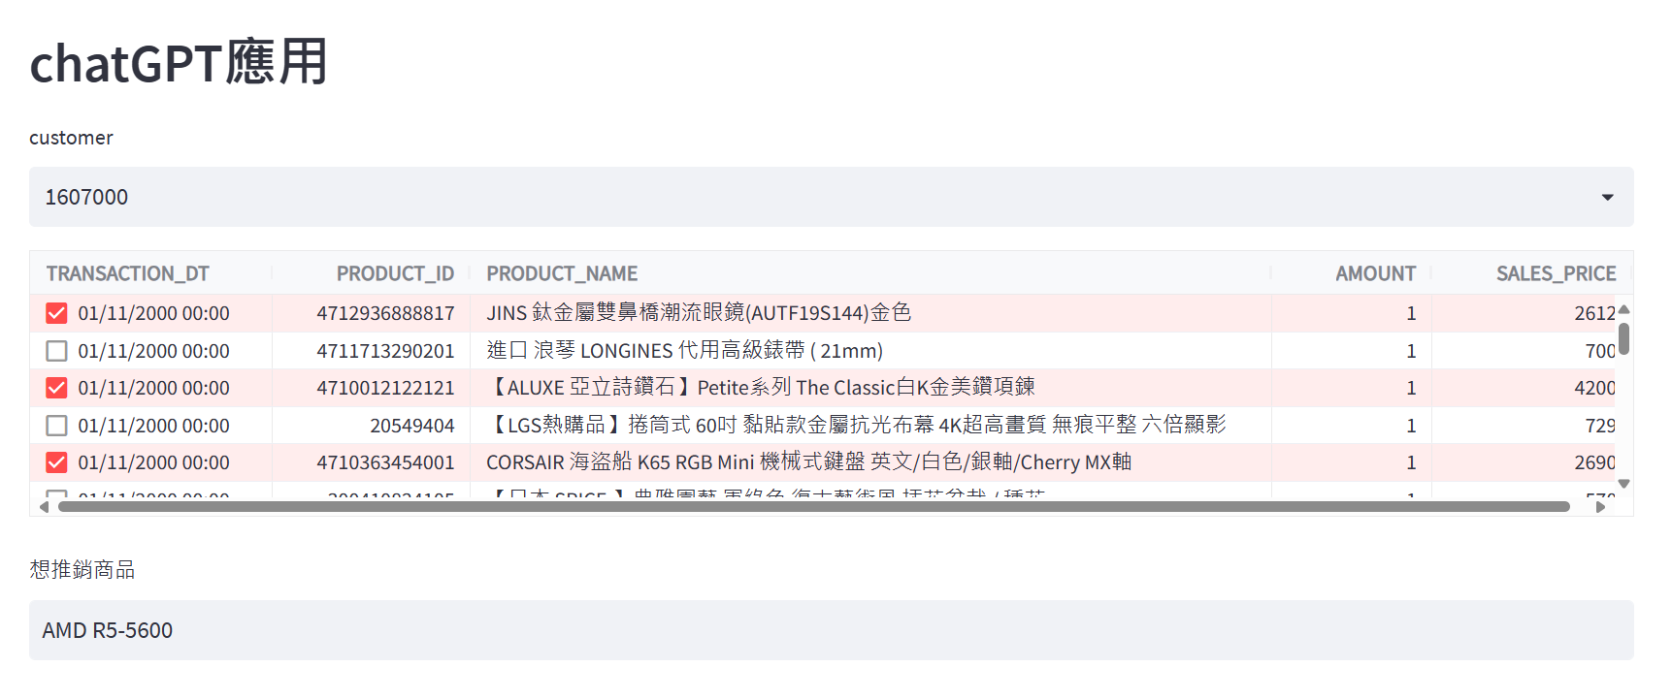
Application for the next lesson

